Slide 1
Studies of quantum boltzmann machines
Philip K. Sørli Niane
University of Oslo

Slide 2
Outline
Motivation
Theory:
Machine Learning
Quantum Computing
Method
Results
Conclusion
Future prospects

Slide 3
Motivation
Machine learning utilizing quantum computing algorithm
Classical Boltzmann machine algorithm translated to Quantum Boltzmann machine
Variational Quantum Boltzmann machine(VarQBM)
Comparison of RBM and other classical machine learning methods and VarQBM
Encodement of features into qubits using neural networks
Ground state energies using VarQITE

Slide 4
Why is machine learning interesting
Central of lots of IT companies
Finding hidden trends in data
Predicting outcomes
Image recognition
Natural language processing

Slide 5
Why is Quantum computing interesting
Classical bits vs quantum bits
Superposition of states
Possible to revolutionize mathematical computations
Quantum computers are still under improvement, but algorithms are still constructed for near term quantum computers
Uses/promises: Fill in more keep it?
Optimization
Quantum chemistry
Cyber security

Slide 6
Theory: Machine learning
Introduction in thesis
Main branches
Supervised learning
Unsupervised learning
Reinforcement learning
Overfitting and different methods and such?

Slide 7
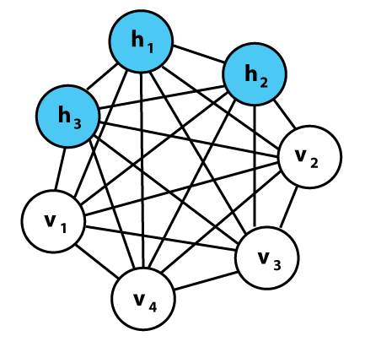
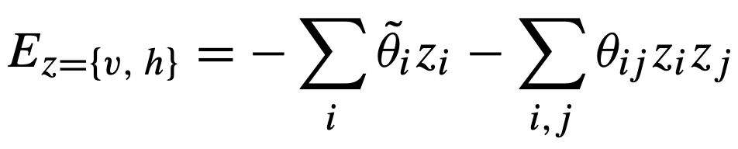
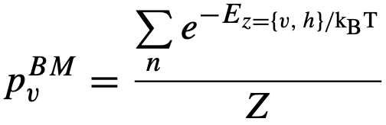
Classical Boltzmann machines
Powerful framework for modelling probability distributions.
Undirected graph structure- Store information in connection weights and biases
Stochastic generative neural network, with visible- and hidden nodes(layers)
Network structure linked to an energy function which facilitates probability distributions over possible node configurations:
Probability to observe certain configuration
Optimizing loss function

Slide 8
Theory: Quantum Computing
Intro and stuff like that
Examples of quantum circuits and gates and such

Slide 9
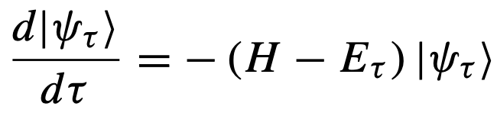
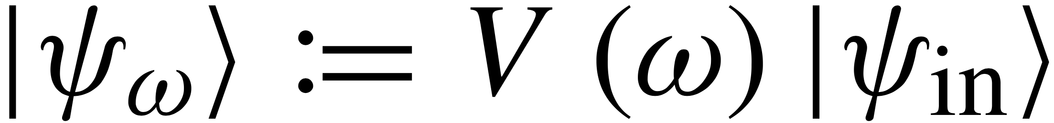
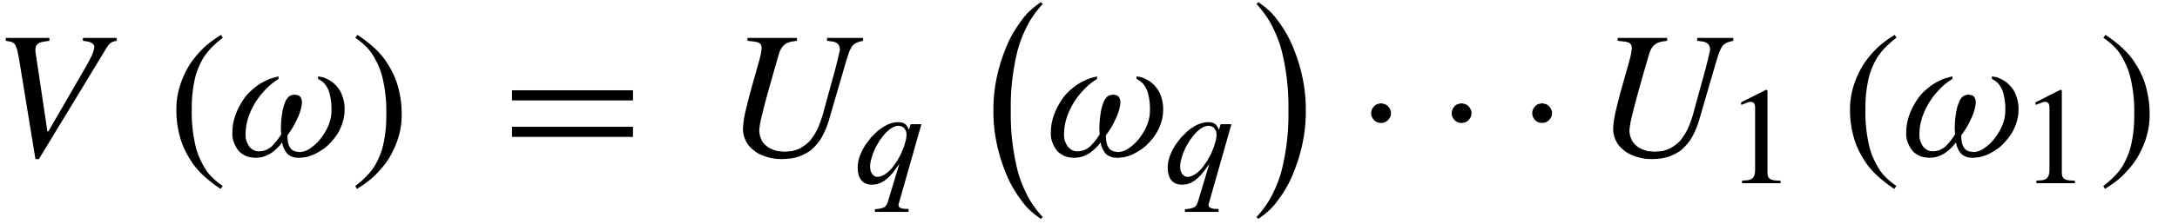
Variational Quantum Boltzmann machine
Imaginary time evolution used for classical ground state
Describe evolution (Wick-rotated S.E.):
Finite time →Gibbs states
Basic idea: Parameterized trial circuit:
.
McLachlan’s variational principle:
.
Basically, find the parameters that minimizes the equation

Slide 10
Method
Generate probability distributions
Bell state
Classification/Regression of classical data
Transaction dataset
MNIST(4 classes)
Franke function
Finding ground state energy of H₂
VarQITE
RBM- Neural network quantum states

Slide 11
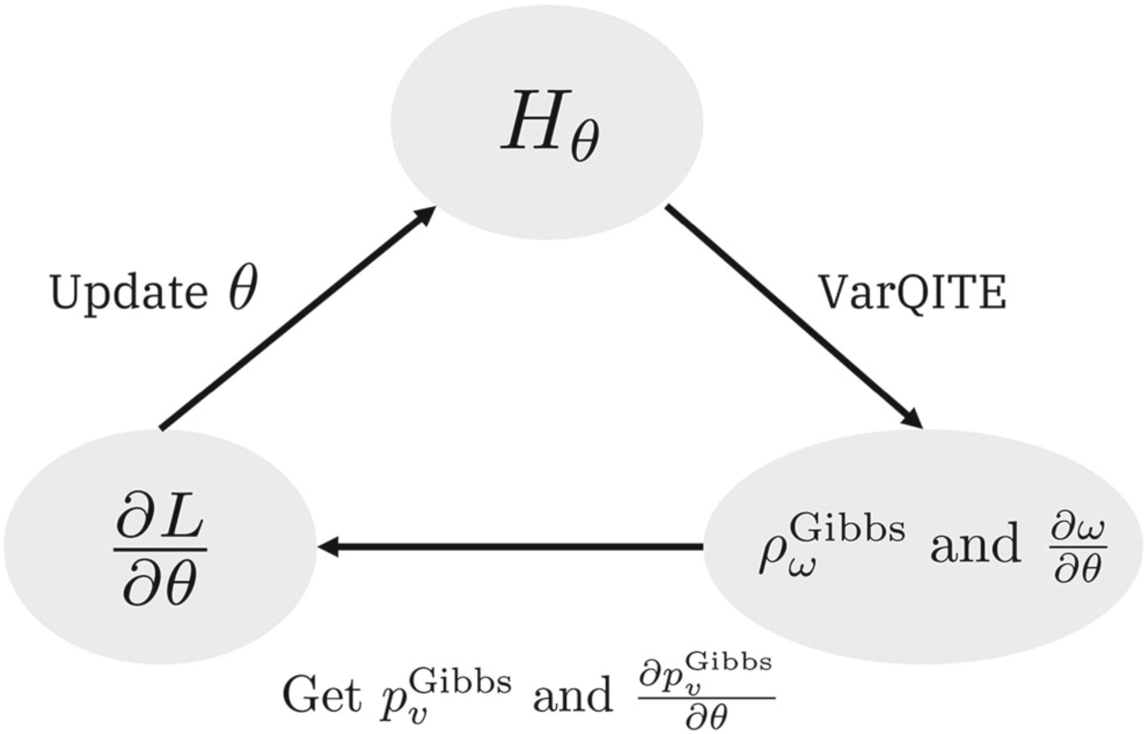
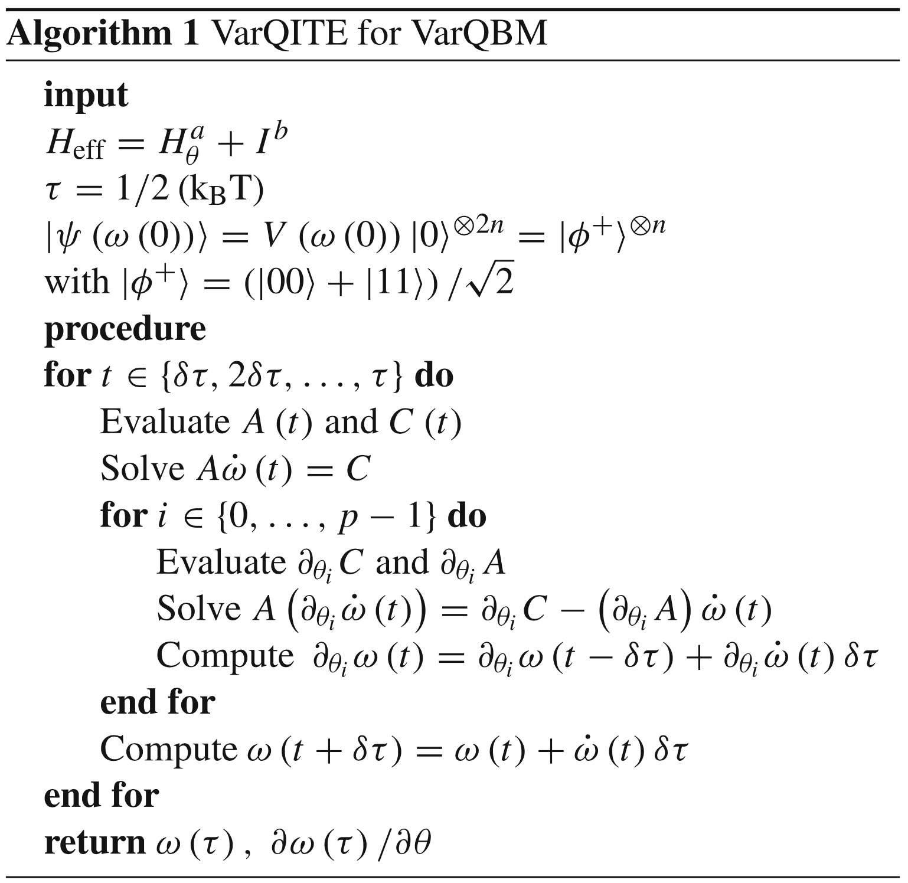
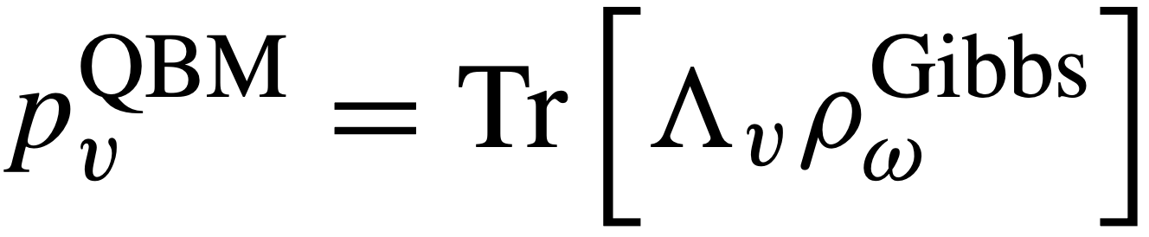
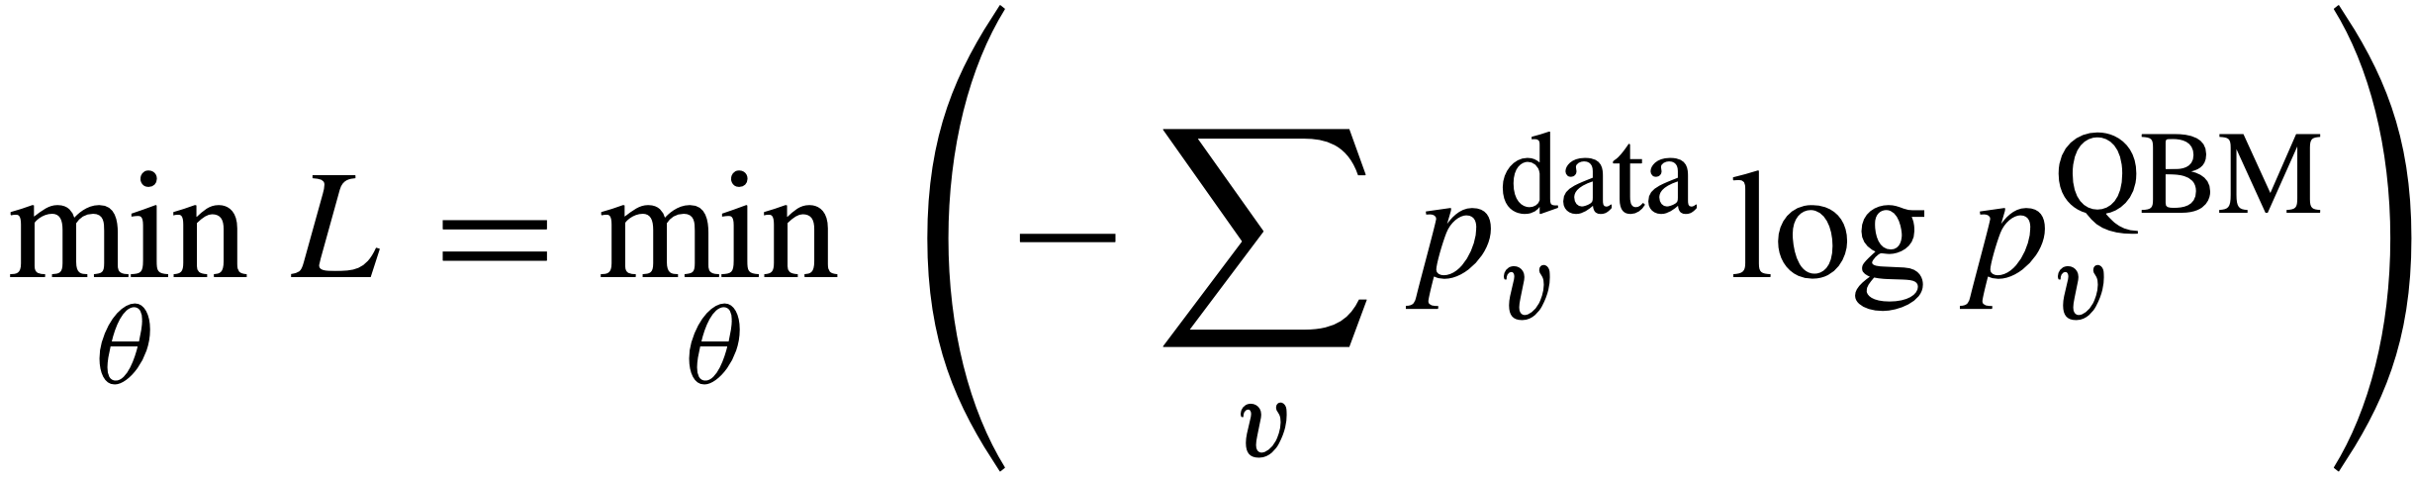
VARQbm: algorithm
Finds BM distribution from:
.
Minimizes loss
.

Slide 12
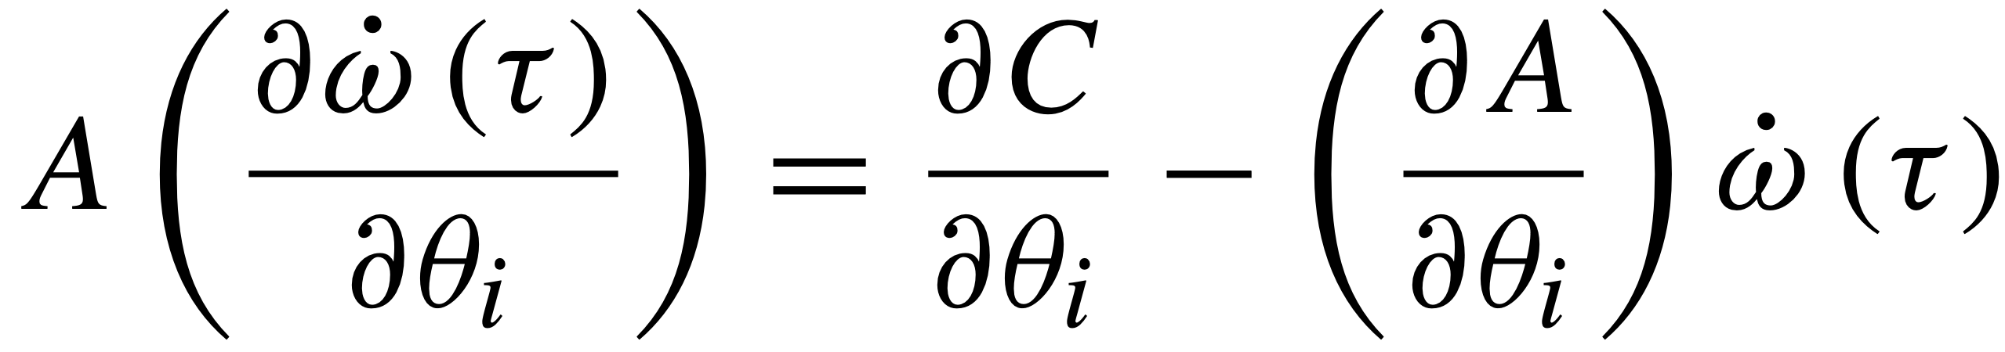

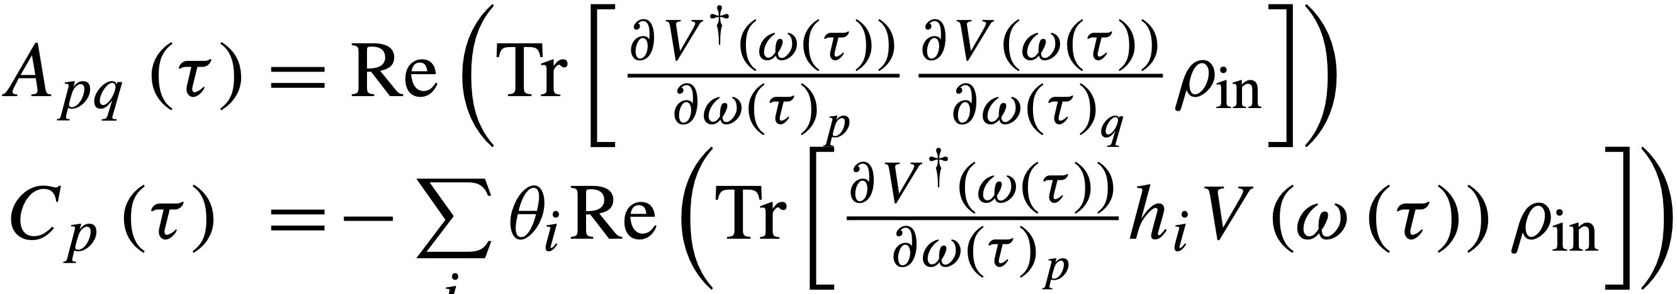
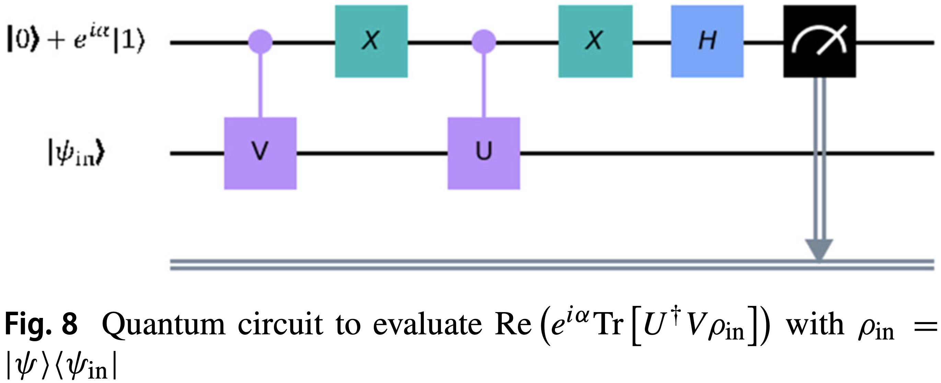
Main Challenge
Solving and
With
.
.
Solved using the generalized circuit:

Slide 13
Ansatzes and Hamiltonians

Slide 14
Neural Network- and Bias encoding

Slide 15
Optimizers and such extra things

Slide 16
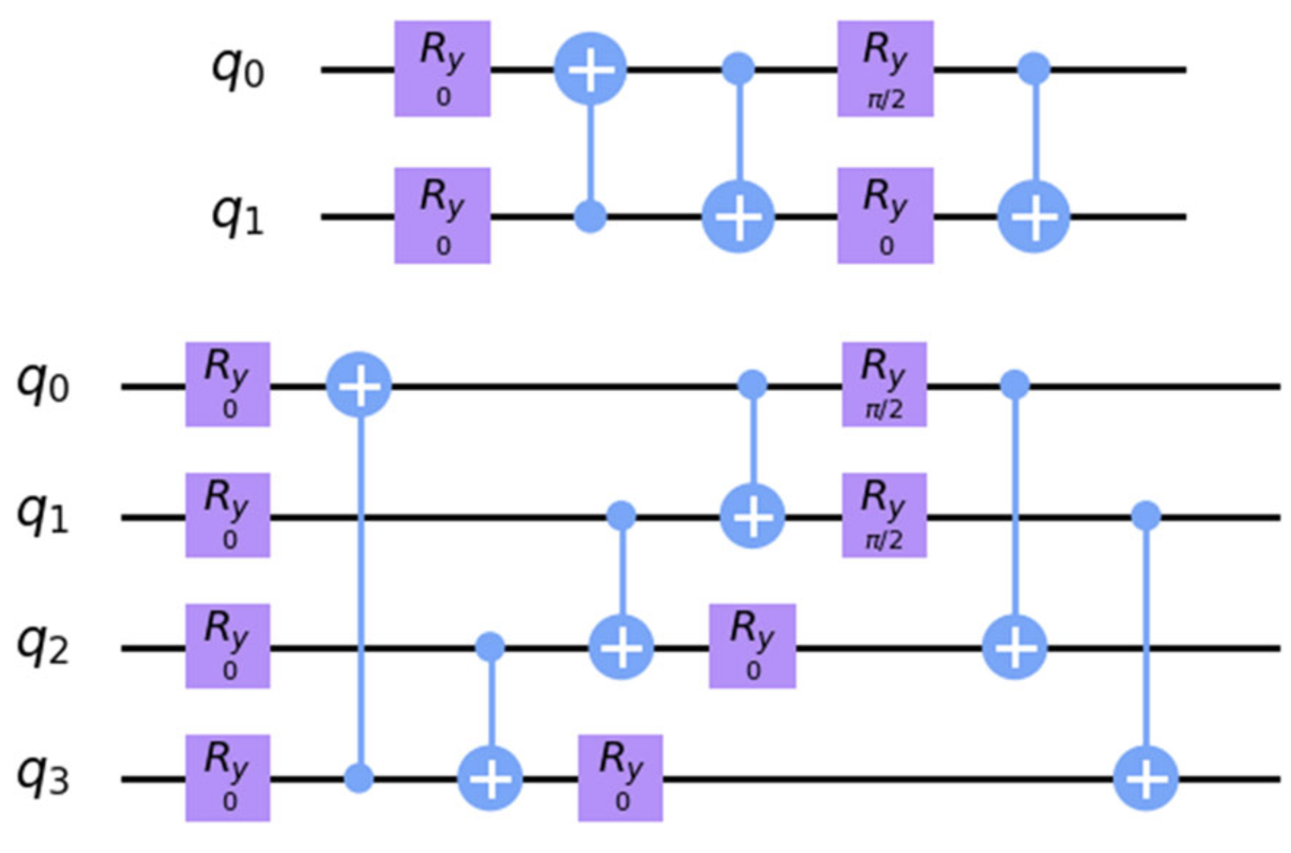
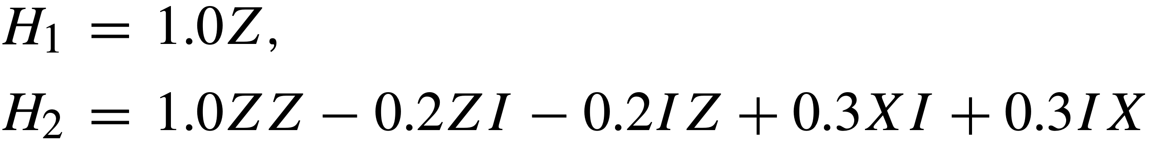
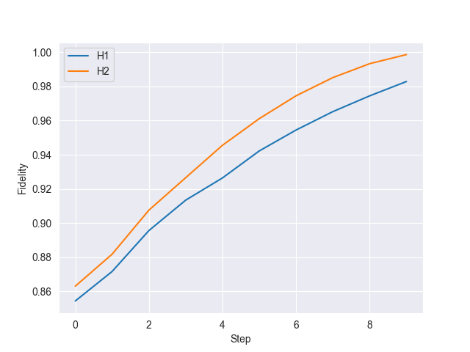
Benchmark: Generation of gibbs states/State preparation
Hamiltonians: Trial circuits:
.
.
10 steps
Ridge: Low lambda but not singular
λ with the least loss
Fidelity compared to analytical solution:
H1: 0.98 and H2: 1.0

Slide 17
RBM using Neural network quantum states(NQS)
Trial wave function and such, show some formulas

Slide 18
Results: Generating Target probability distribution
Insert results and figures and such

Slide 19
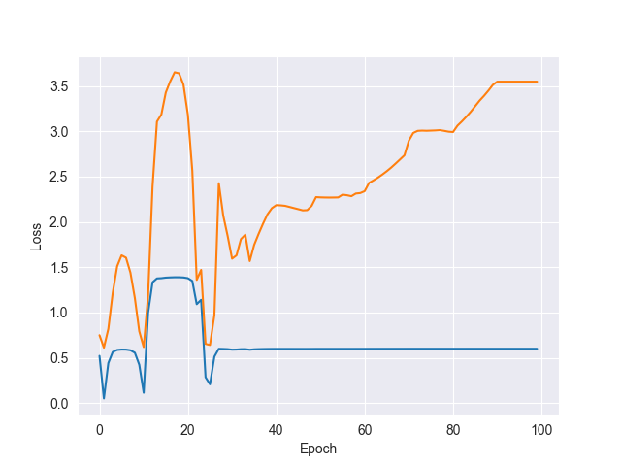
Results: Training the QBM
Reproduce [0.7, 0.3]
Hamiltonian: H= 𝛳₀ Z
Uniform distribution [-0.5,0.5]
AmsGrad optimizer,
𝛾=0.1, m1=0.7, m2=0.99
Ansatz 1
(Without finetuning and optimal parameters)
If 2 plots: Blue=L1 norm, Orange=Loss

Slide 20
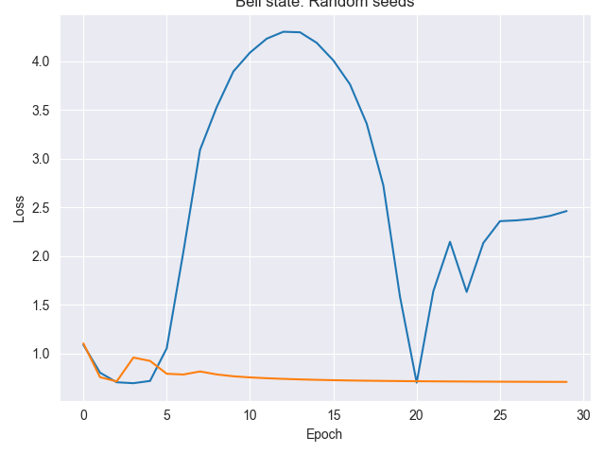
Results: Training the QBM
Hamiltonian: H= 𝛳₀ Z Z+𝛳₁ Z I +𝛳₂ I Z
Ansatz 2
Target: [0.5, 0, 0, 0.5]
𝛾=0.1, m1=0.8, m2=0.99
2 seeds, both loss

Slide 21
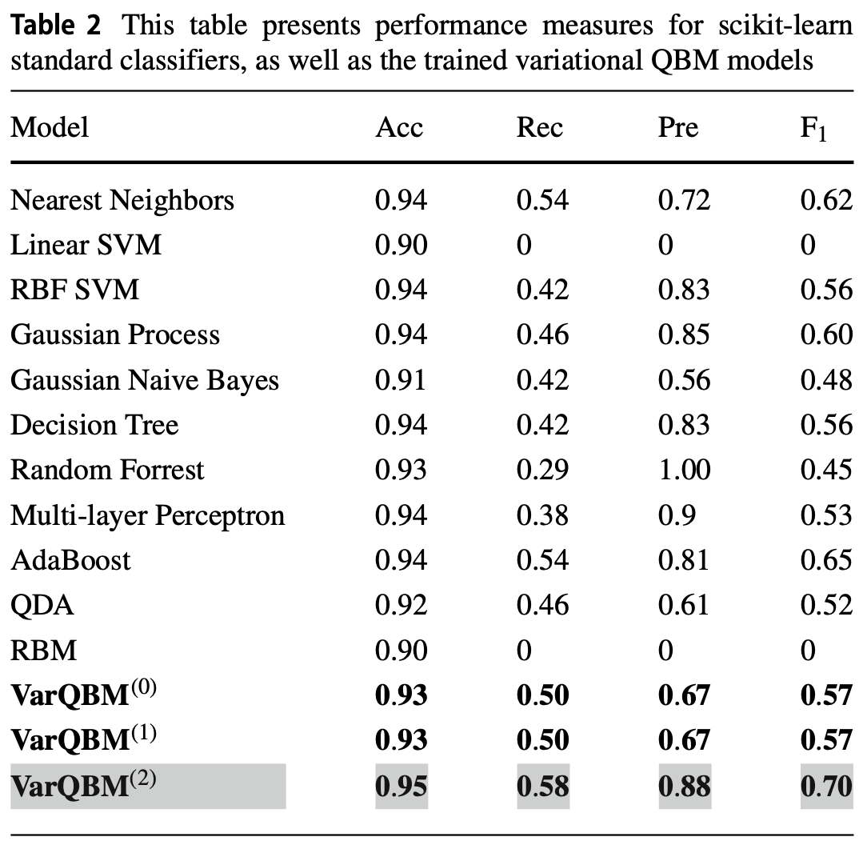
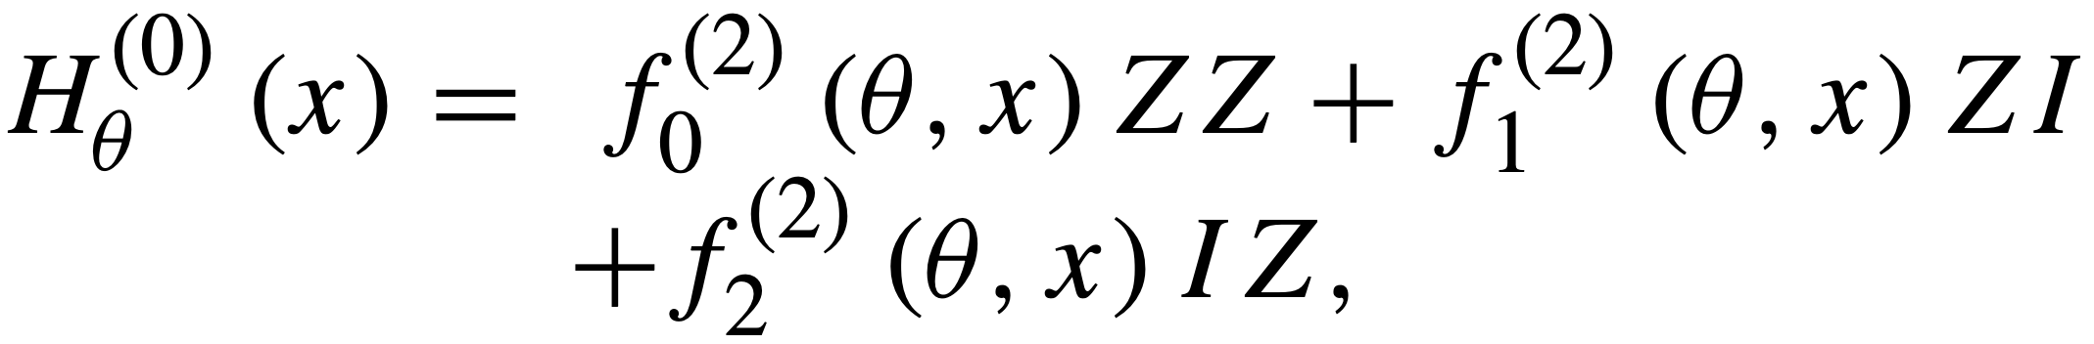
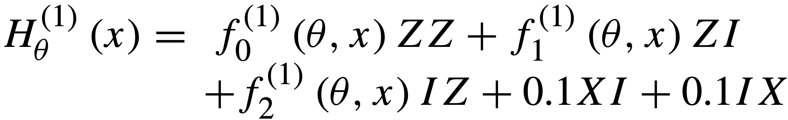
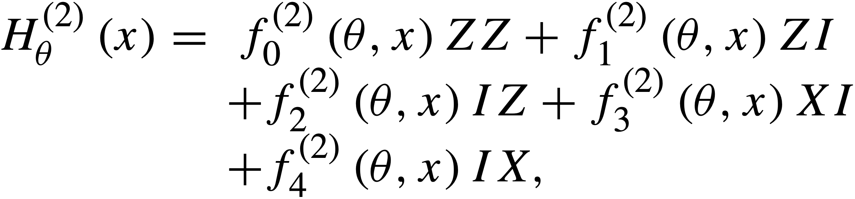
Further work
Focus a bit on the classical BM
Finetune both classical- and quantum BM
Reproduce more results from the article
Might try to overcome results from the article
achieved on the fraud dataset by testing some
more powerful Hamiltonians, these were used:

Slide 22
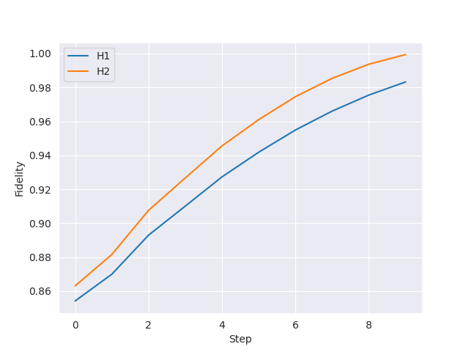
Results: State preparation
H₁=𝛳₀ Z
H₂=𝛳₀ ZZ+𝛳₁ IZ+𝛳₂ ZI
Fidelities 0.98 and 1.0 for H1 and H2
Think it is due to singular values
(3 of 4 elements along diagonal = 0)
‘However, since the algorithm is employed in
the context of machine learning, we do not
necessarily require perfect state preparation.‘

Slide 23
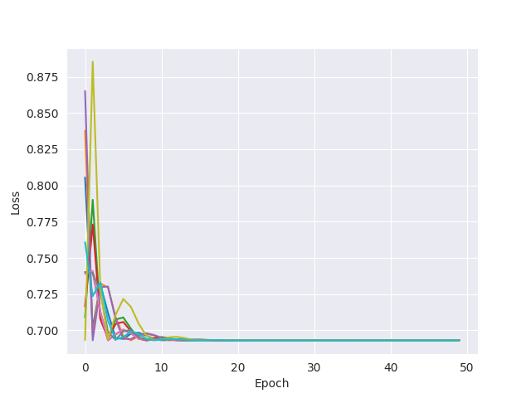
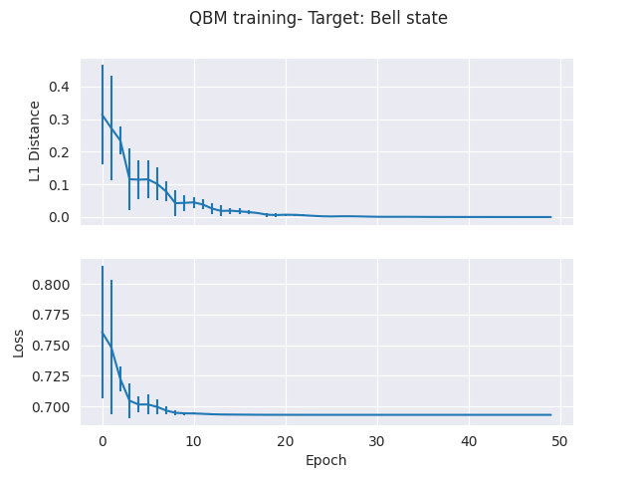
Results: H₁ Generating distribution
10 seeds, [-1, 1] uniform distribution
Target: [0.5, 0.5]

Slide 24
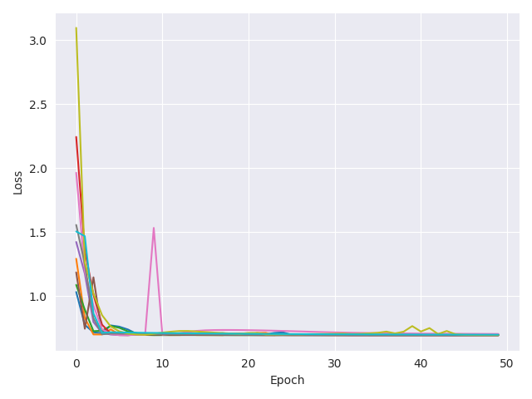
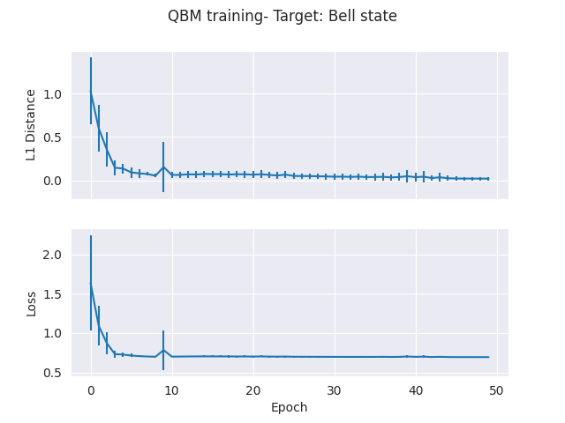
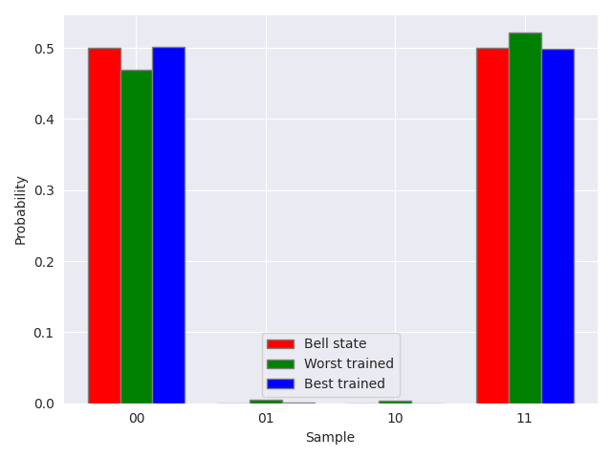
Results: H₂ Generating Bell State
10 seeds, [-1, 1] uniform distribution
Target: Bell state
Notes:
lr100.04H2_latest_10_seeds_both.png

Slide 25
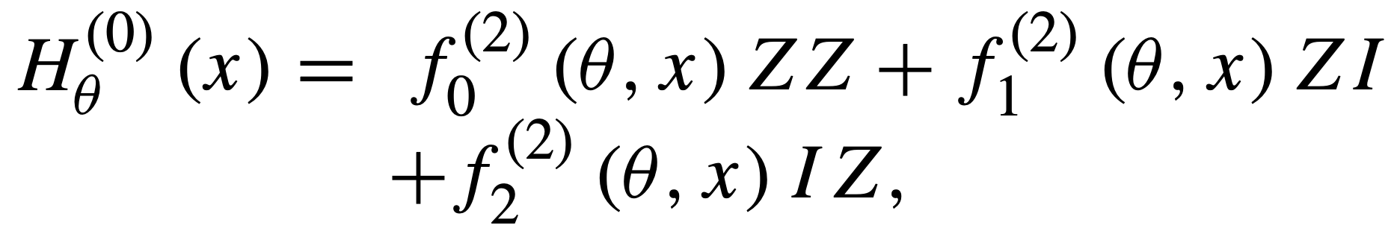
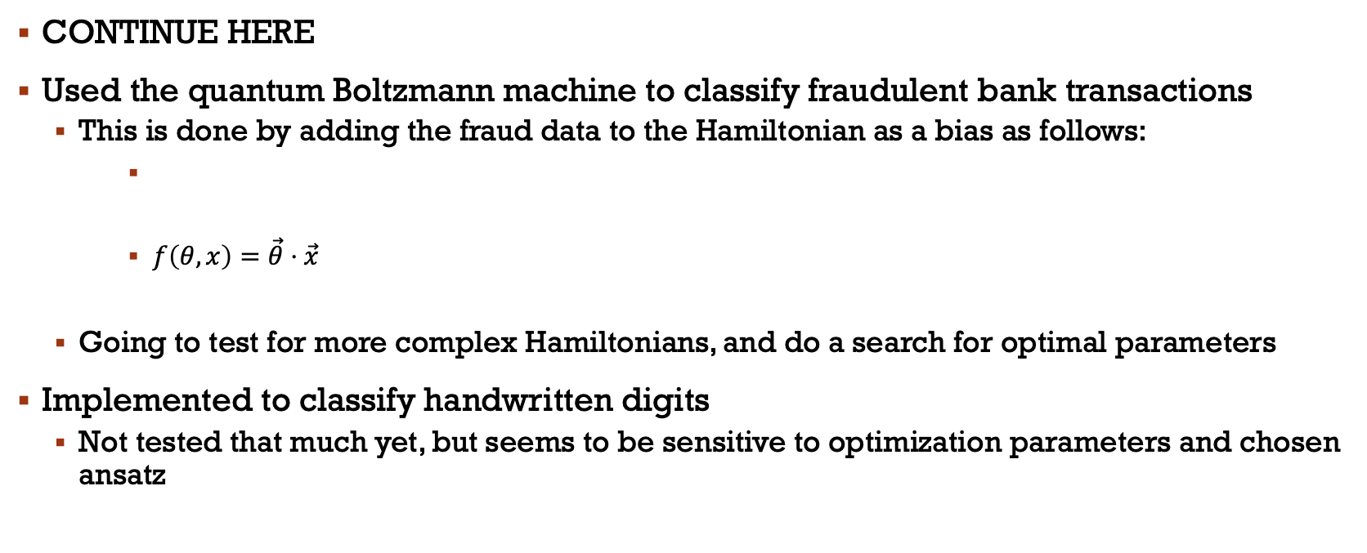
Discriminative Learning: Transaction dataset
CONTINUE HERE
Used the quantum Boltzmann machine to classify fraudulent bank transactions
This is done by adding the fraud data to the Hamiltonian as a bias as follows:
$f\left(θ, x\right)=\vec{θ}⋅\vec{x}$
Going to test for more complex Hamiltonians, and do a search for optimal parameters
Implemented to classify handwritten digits
Not tested that much yet, but seems to be sensitive to optimization parameters and chosen ansatz

Slide 26
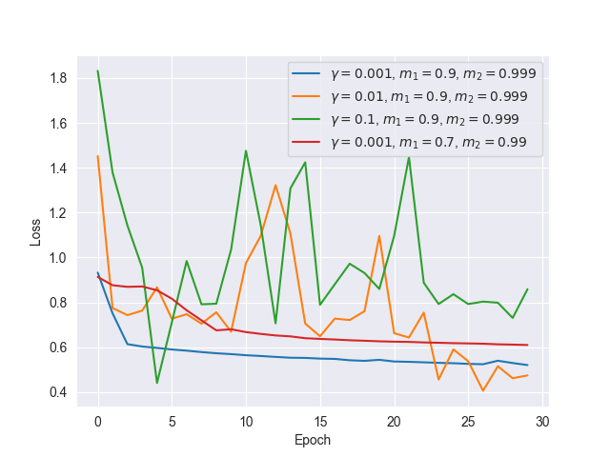
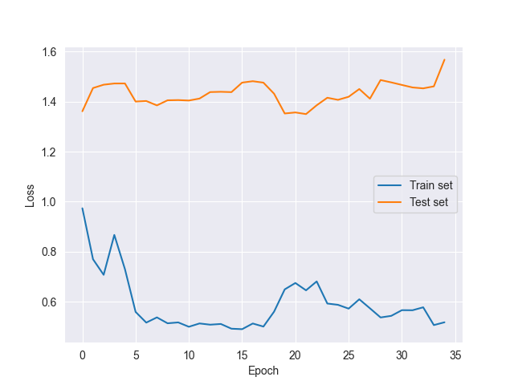
Fraud: Playing a bit with parameters
10 samples to inspect that the loss reduces
30 samples, 𝛄=0.005

Slide 27
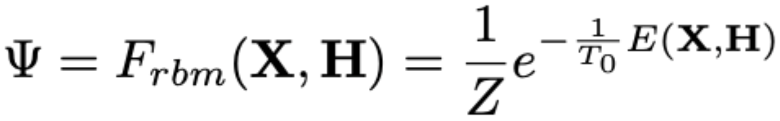
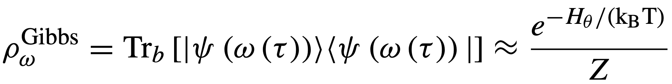
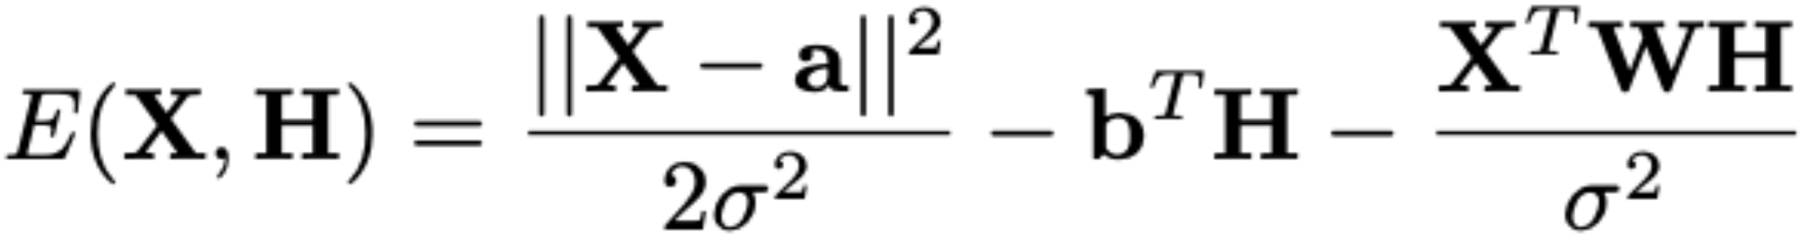
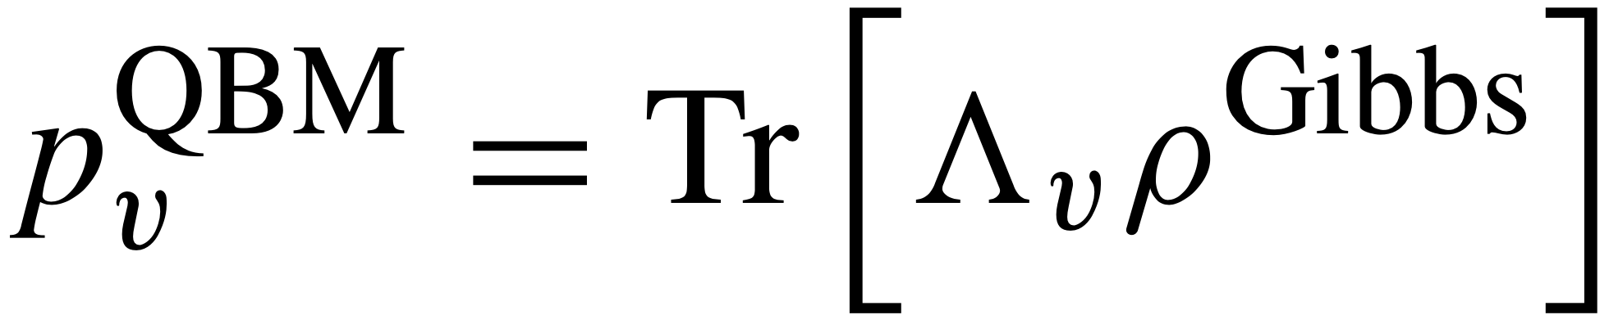
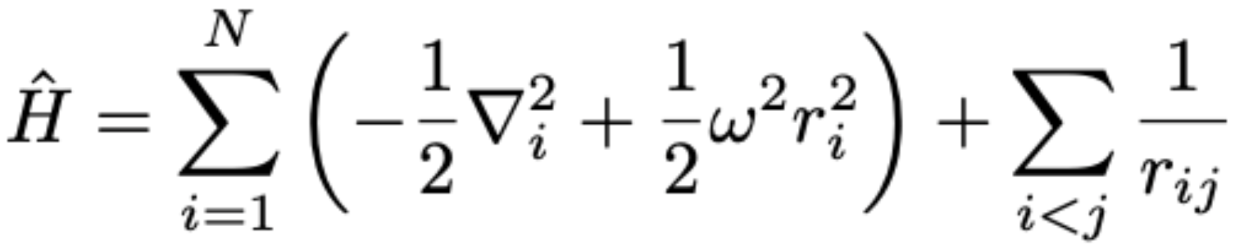
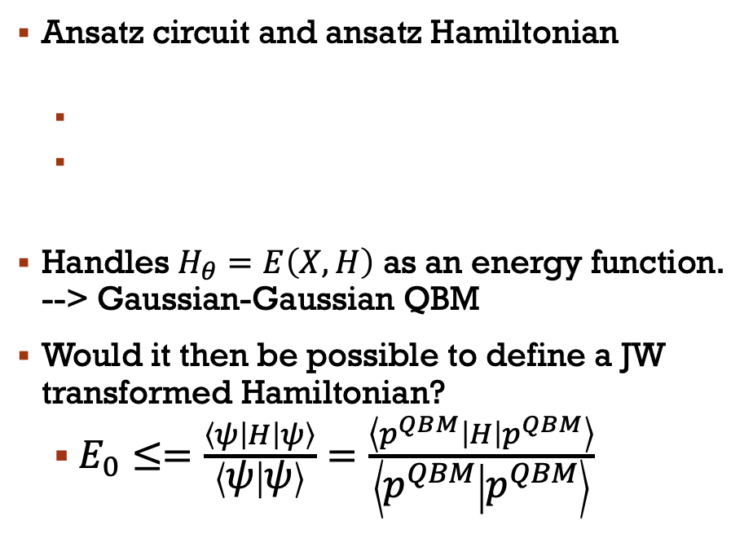
Apply QBM to quantum system: IDEA
Classic BM
Quantum BM
One ansatz(NQS):
Ansatz circuit and ansatz Hamiltonian
Handles $H_{θ}=E\left(X,H\right)$ as an energy function. --> Gaussian-Gaussian QBM
Would it then be possible to define a JW transformed Hamiltonian?
$E_{0}≤=\frac{\left\langle ψ\left|H\right|ψ\right\rangle }{\left\langle ψ | ψ\right\rangle }=\frac{\left\langle p^{QBM}\left|H\right|p^{QBM}\right\rangle }{\left\langle p^{QBM} | p^{QBM}\right\rangle }$

Slide 28
Plan further on:
Complete the Jordan Wigner transformation of the pairing Hamiltonian and maybe some other Hamiltonian also?
Compute the energy/Check if the p^QBM is an eigenstate, compare with the classical BM
Run the QBM on the fraud dataset, find best parameters and test with multiple H_\theta
Run the QBM with handwritten digits
Write thesis
Include more if not enough/ or more time

